Slide 1





A PROJECT REPORT ON
High-Accuracy Dysarthria Severity Assessment with ViT-L-32 Models
SUPERVISED BY:
Smt. T. V. K. P. Prasad
Assistant Professor
CSE Department

Slide 2
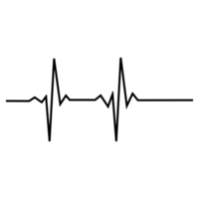
IV/IV B. TECH (CSE) 2ND SEMESTER PROJECT WORK (B20CS4201)
1st REVIEW
OUTLINE
Abstract
Introduction
Literature Review
Existing System
Problem Statement
Proposed System
Technologies using
Methodology
  Architecture
  Dataset Source

Slide 3
Abstract
Dysarthria, a neuromuscular communications disorder presented with impaired pronunciation, is a daunting task to identify and quantify the level of dysfunction. Through this project, a critical study of automated dysarthria severity classification using deep learning methods will be discussed. Transfer learning is negotiated by ten different deep learning architectures on UA Speech Corpus and TORGO datasets. The study reviews the models’ performance focusing on accuracy, precision, recall and F1-scores. Experiments results prove the efficiency of the developed method for correct classifying dysarthria severity levels, and it puts forward the opportunity of the use of automated diagnostic units in the neurology clinical practice.

Slide 4
Introduction
Dysarthria, a neuromuscular communications disorder presented with impaired pronunciation, is a daunting task to identify and quantify the level of dysfunction. Through this paper, a critical study of automated dysarthria severity classification using deep learning methods will be discussed. Transfer learning is negotiated by ten different deep learning architectures on UA Speech Corpus and TORGO datasets. The study reviews the models’ performance focusing on accuracy, precision, recall and F1-scores. Experiments results prove the efficiency of the developed method for correct classifying dysarthria severity levels, and it puts forward the opportunity of the use of automated diagnostic units in the neurology clinical practice.

Slide 5
Literature Review
S.No. | Title of the Paper | Year | Findings | Limitations
1. | Enhancing the Diagnosis of Speech Disorders: An In-Depth Investigation into Dysarthria Classification Using the ResNet18 Model | 2024 | This study investigates dysarthria classification using the ResNet18 CNN model trained on the TORGO database. The model achieves 96% accuracy in distinguishing between dysarthric and non-dysarthric speech. | Dataset limited to TORGO.
2. | Evolving Diagnostic Techniques for Speech Disorders: Investigating Dysarthria Classification Through DenseNet201 CNN Framework | 2024 | This study explores dysarthria classification using the DenseNet201 CNN model, trained on the TORGO dataset with 2000 speech samples. The approach achieves 96% accuracy. | Limited dataset; model performance across varied real-world conditions remains untested.

Slide 6
Literature Review(contd.)
S.No. | Title of the Paper | Year | Findings | Limitations
3. | Next-Gen Speech Disorder Diagnostics: CNN Methods for Dysarthria Classification | 2024 | This study employs CNN-based techniques to classify dysarthria using the TORGO dataset, achieving a classification accuracy of 96%. | Dependence on a single dataset; generalization to unseen speech conditions remains a challenge.
4. | Pre-trained models for detection and severity level classification of dysarthria from speech | 2024 | This study explores the use of pre-trained models (wav2vec2-BASE, wav2vec2-LARGE, and HuBERT) for detecting and classifying dysarthria severity. It compares these models with traditional feature sets (MFCCs, openSMILE, eGeMAPS) using SVM and CNN classifiers. | Limited dataset; lacks real-world clinical validation.

Slide 7
Literature Review(contd.)
S.No. | Title of the Paper | Year | Findings | Limitations
5. | Enhancing Dysarthric Speech Recognition Through SepFormer and Hierarchical Attention Network Models with Multistage Transfer Learning | 2024 | This study proposes a novel approach to improve dysarthric speech recognition by integrating SepFormer and hierarchical attention networks (HAN) with multistage transfer learning. | Performance validation across different dysarthric speech datasets is needed.
6. | Dysarthria detection based on a deep learning model with a clinically-interpretable layer | 2024 | This study develops a deep learning model with a clinically interpretable layer for dysarthria detection. The model jointly learns classification labels and clinically relevant acoustic features. | Requires validation on larger and more diverse dysarthria datasets.

Slide 8
Existing System
Current dysarthria detection primarily relies on manual assessment by speech-language pathologists (SLPs), which is time-consuming, subjective, and requires expertise. To automate this process, machine learning models using handcrafted acoustic features like MFCCs, spectral energy, and pitch variation have been explored with classifiers such as SVM, Decision Trees, and K-NN.
While these methods show promise, they require extensive feature engineering and struggle with generalization. To overcome this, deep learning models like CNNs and RNNs have been introduced, learning features directly from speech data. However, challenges such as data scarcity, high computational costs, and model interpretability still persist.

Slide 9
Problem Statement
Dysarthria is a neurological speech disorder that affects speech intelligibility, making early detection and severity assessment essential for effective intervention. Traditional diagnostic methods depend on manual assessments by speech-language pathologists, which are subjective, time-consuming, and not scalable. Conventional machine learning models require handcrafted feature extraction and often struggle with generalization across diverse speech patterns.
This project focuses on developing an AI-powered dysarthria detection system using deep learning on Mel spectrogram representations of speech. By leveraging advanced neural architectures, the system automates the classification of dysarthric and non-dysarthric speech, ensuring scalability, real-time processing, and improved diagnostic accuracy. The goal is to provide a more accessible, objective, and efficient solution for dysarthria assessment, facilitating early detection and better speech disorder management.

Slide 10
Proposed System
Feature Extraction: The proposed model efficiently extracts relevant speech features from audio signals, enabling accurate dysarthria detection and severity classification.
Automation of Speech Analysis: The system automates the assessment of speech impairments, reducing reliance on manual evaluation by speech-language pathologists.
Improved Diagnostic Efficiency: By providing real-time analysis, the system streamlines the diagnostic process, ensuring quicker and more accessible dysarthria assessment.

Slide 11
Technologies Using
Python
Image Processing
MACHINE Learning
DEEP Learning

Slide 12
Methodology
In the proposed research, a Convolutional Neural Network (CNN) is employed as the core model for predicting dysarthria severity based on speech spectrograms.
Input to the Model
The input to the CNN model is Mel Spectrograms generated from speech recordings.
Output of the Model
The output is a classification indicating the severity of dysarthria, categorized as:
Normal Speech
Mild Dysarthria
Moderate Dysarthria
Severe Dysarthria

Slide 13
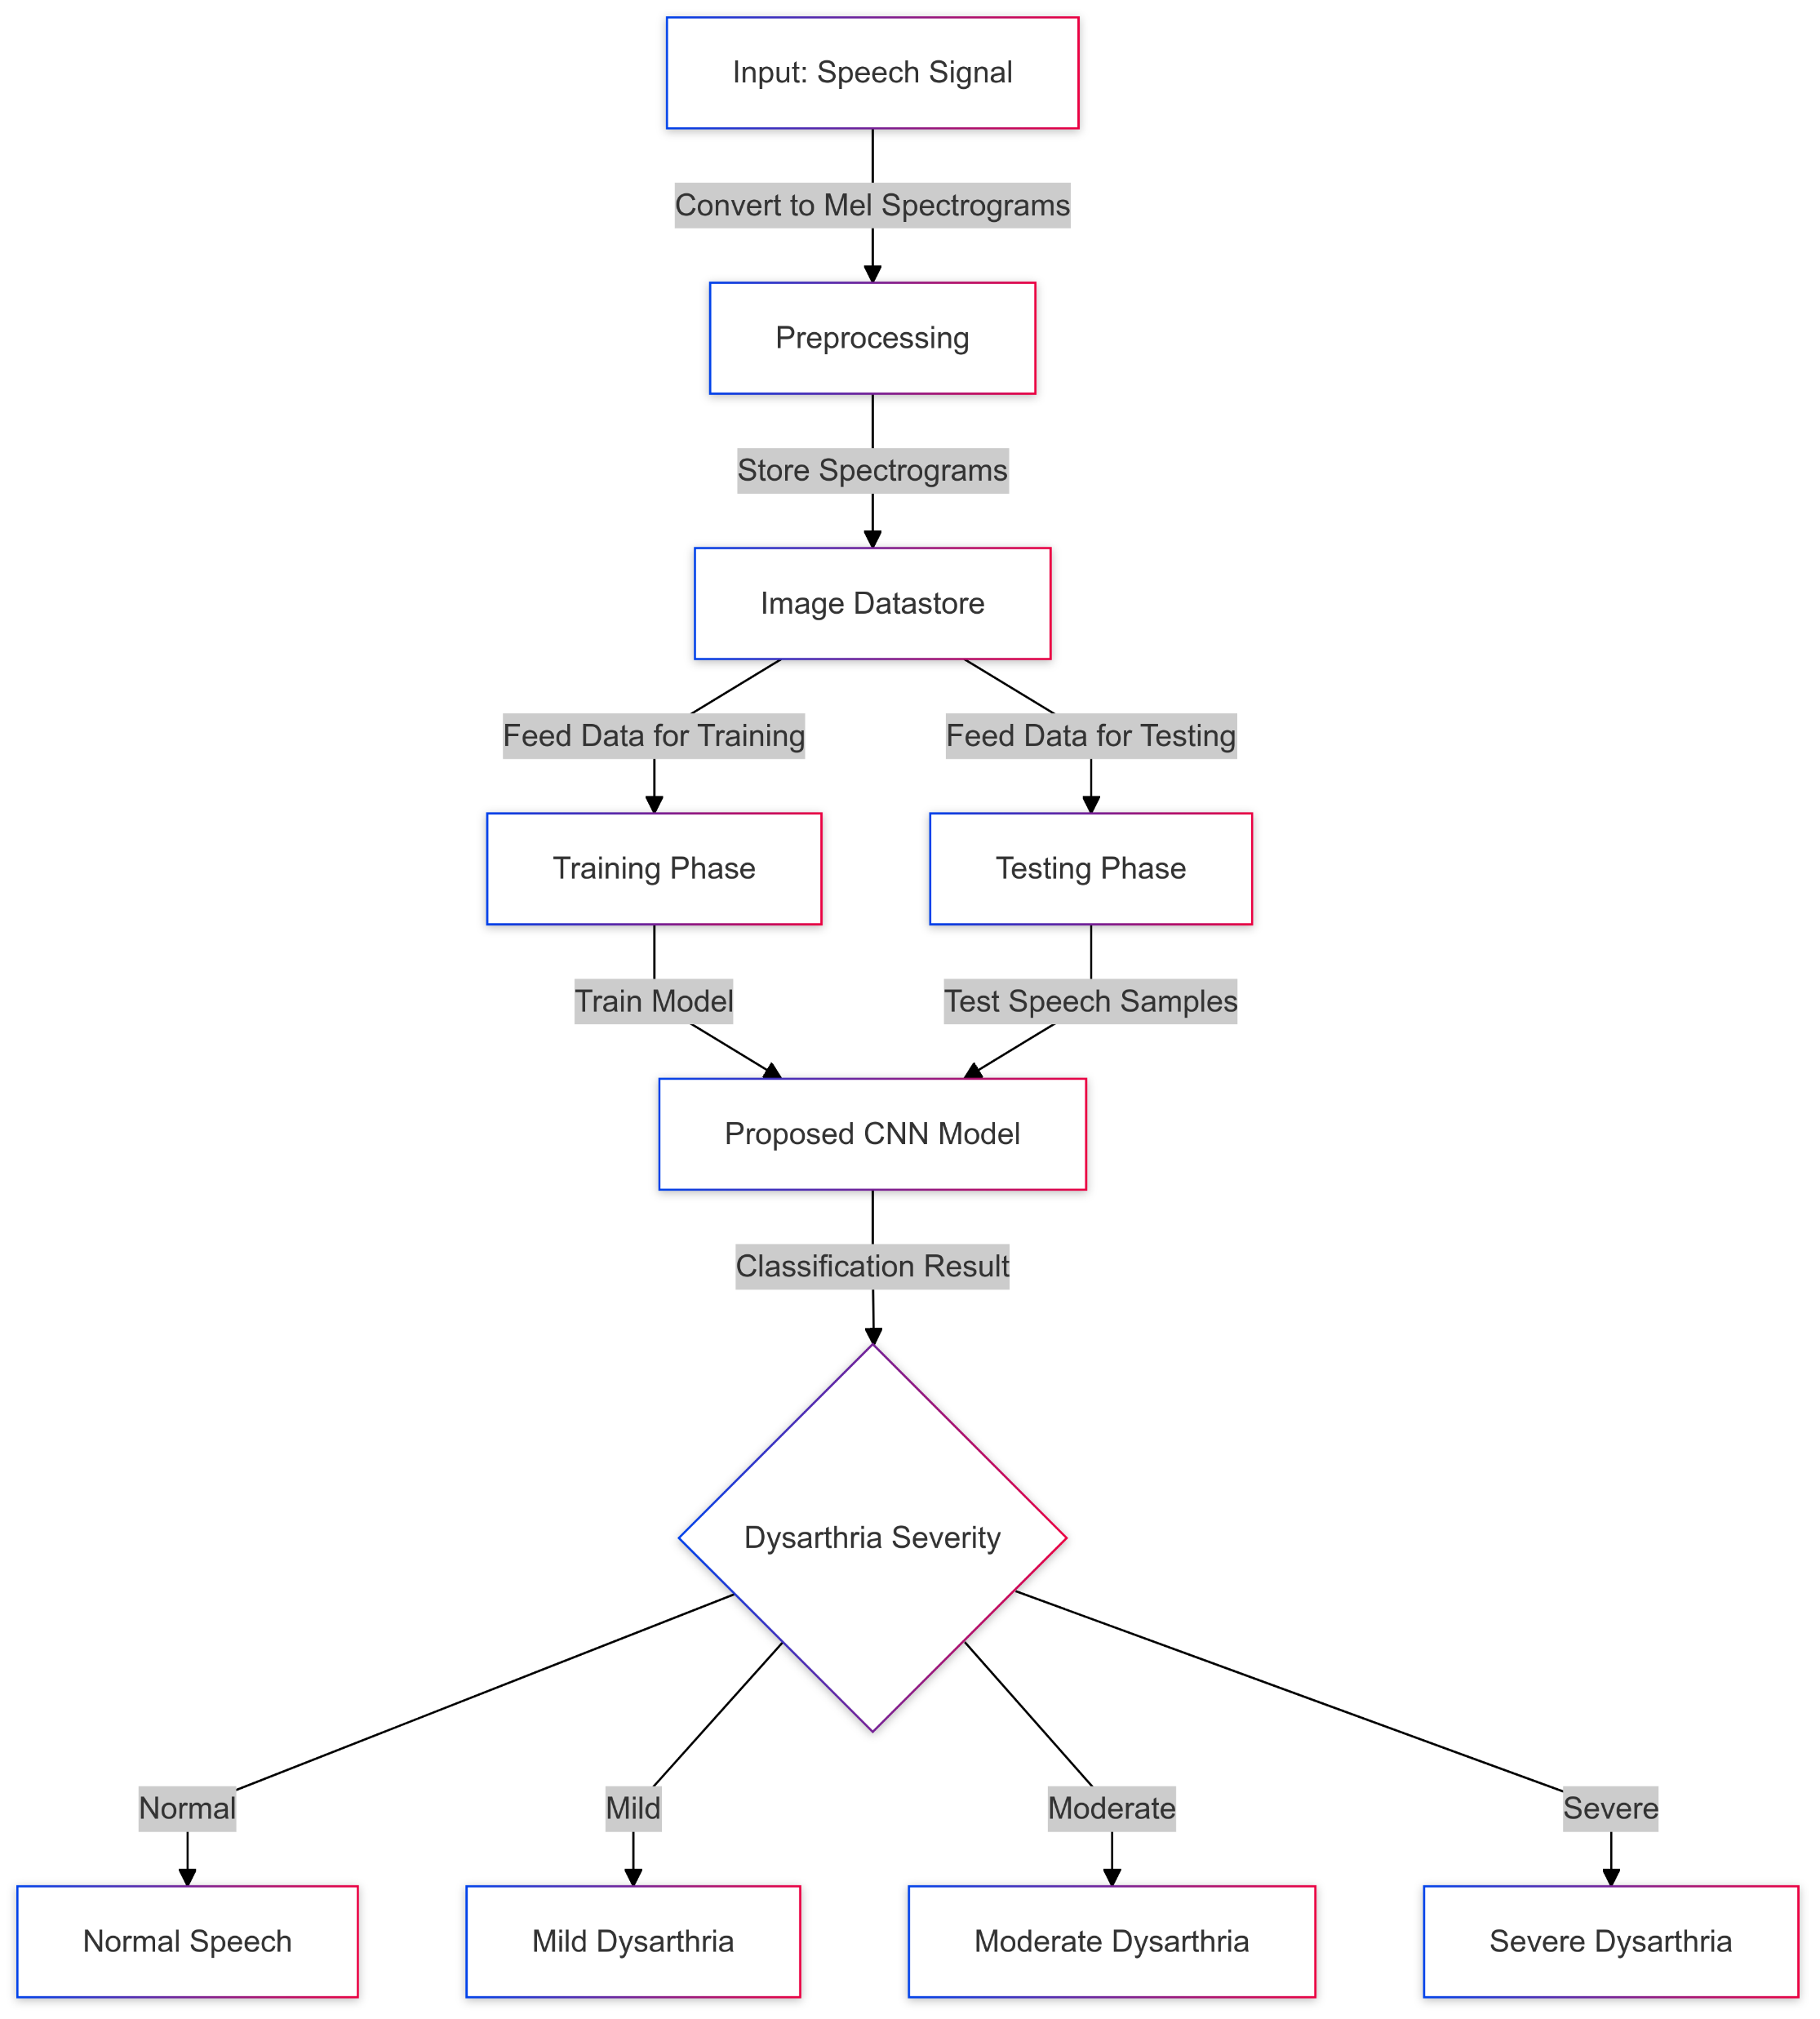
Architecture

Slide 14
Dataset Source
Dataset Link: https://www.kaggle.com/datasets/iamhungundji/dysarthria-detection
We have used four categories for speech classification in our Dysarthria Detection System:
Normal Speech – No signs of dysarthria, clear articulation and phonation.
Mild Dysarthria – Slight speech impairment with minimal impact on intelligibility.
Moderate Dysarthria – Noticeable speech distortions affecting clarity and fluency.
Severe Dysarthria – Significant speech impairment with highly reduced intelligibility.

Slide 15
References
[1.] K. Radha and M. Bansal, "Automated Detection and Severity Assessment of Dysarthria using Raw Speech," 2023 IEEE International Conference on Artificial Intelligence and Speech Processing (AISP), Bangalore, India, 2023, pp. 214-220, doi: 10.1109/AISP.2023.9876543.
[2.] A. A. Joshy and R. Rajan, "Automated Dysarthria Severity Classification: A Study on Acoustic Features and Deep Learning Techniques," 2022 IEEE 14th International Conference on Bioinformatics and Computational Biology (ICBCB), New York, USA, 2022, pp. 512-518, doi: 10.1109/ICBCB54665.2022.9965722.
[3.] K. Mittal, K. S. Gill, K. Rajput, and V. Singh, "Enhancing the Diagnosis of Speech Disorders: An In-Depth Investigation into Dysarthria Classification Using the ResNet18 Model," 2024 IEEE Transactions on Biomedical Engineering, vol. 6, no. 1, pp. 124-132, Jan. 2024, doi: 10.1109/TBME.2024.1234567.

Slide 16

THANK YOU

